Slide 1

Daniel Goltz
An introduction to ASP.NET MVC

Slide 2
What’s a Web Application Framework (and why do we need it)
One minute history lesson
CGI
Web Scripting Languages
Web Servers
A Web Application Framework provides built-in tools made for Web Development and reduces boilerplate code
HTML Templating
Session Management
Database Access
Authentication and Authorization
WAF isn’t just a library
Enforces some sort of design pattern
Enforces a custom file structure
Requires custom support by the Web Server
Notes:
In the early days of the internet, when one wanted to develop a dynamic website, he would write in CPP/Perl or other languages, perform logic and join together strings that make up a valid HTML file. This script or executable would then be launched as a separate process by the operating system. This method was called CGI – Common Gateway Interface.
Later during the 90s, languages & frameworks suited specifically for Web development were created – such as PHP, Classic ASP, ColdFusion, and others. These languages operated on a ‘smart’ server that provided integrated modules for these languages, which allowed better performance. The languages themselves were more suited to working with Web projects.
A Web Application Framework is designed to further reduce overhead costs, by enforcing a development model of some sort and promote code reuse – and provide many capabilities built-in – such as security, session management, templating and database access.

Slide 3
The MVC Pattern
Controller
PersonController
GetAllPepole()
GetPersonById(int id)
Model
Person
Id
Name
Address
View
<html>
<li>
<ul>Person 1</ul>
<ul>Person 2</ul>
</li>
</html>
Notes:
The MVC model is made up from three different components – Model, Controller & View.
Model – a simple class representing the data structure of our business object. For example, a Person class would contain a Name, Email, and other relevant properties. A typical Model class does not contain any methods.
View – represents the actual interface the user sees. A view can be an HTML file in the Web context.
Controller – a class which contains methods that implement the business logic of the application. Each method returns a specific View. Before returning the View, we perform the necessary operations – such as querying the database – to have everything we need in the View.
It’s important to note that MVC is just a design pattern, and the implementation varies between every language and Web Application Framework.

Slide 4
The Unfortunate Family of ASP.NET
ASP.NET is typically associated with ASP.NET WebForms
Time to clear up
ASP.NET = part of the .NET FCL, core components for Web Development
ASP.NET WebForms = older implementation of a Web Application Framework which attempted to provide a WinForms-like experience
ASP.NET MVC = based on the core ASP.NET stack, but completely differs from ASP.NET WebForms
Notes:
Microsoft has had some troublesome decisions with naming its ASP.NET product family.
Even though ASP.NET refers to an entire stack in the .NET Framework Class Library, which contains core components for Web Development in the .NET world, most developers think of ASP.NET Web Forms when they hear the name.
ASP.NET Web Forms is Microsoft’s older implementation of a Web Application Framework. It attempts to provide a WinForms-like development experience, by defining a subset of HTML, allowing developers to declare ‘controls’ and access them through a Code Behind file. In addition, Web Forms applications have had the ability to store state in them, which was performed by sending the state in a hidden part of the HTML document, back and forth from the client to the server. This created performance issues in larger applications that heavily relied on state.
ASP.NET MVC was created on top of the core ASP.NET stack, but differs a lot from the classic ASP.NET WebForms. It was introduced in 2008 and embraces many design standards and conventions that other MVC frameworks, primarily Ruby on Rails, have introduced over the years.

Slide 5
DEMO: Hello ASP.NET MVC!
Notes:
DEMO

Slide 6
ASP.NET MVC Views
Served by the controller to the client
Somewhat of an HTML page
Allows you to interact with C# models and generate HTML in order to display them
Can be divided into parts:
Partial View – will be rendered within another view
Layout Page – will render another regular view within it (like a template)
Notes:
We will cover Layout page later on

Slide 7
View Engines
ASP.NET MVC uses a technique called templating
Templating allows us to embed C# code ‘inside’ our HTML pages
The view engine renders the code into HTML in the server
ASP.NET MVC allows you to select your own view engine:
Web forms view engine – has an ASP-like syntax. It is the default for ASP.NET MVC 1 and 2 applications.
Razor – ASP.NET MVC’s 3 and up default engine. Developed by Microsoft
Spark – open-source engine that aims to seamlessly integrate code and HTML
NHaml – an open-source port of the Ruby on Rails Haml view engine. Aims to replace HTML tags with an easier to read and better organized syntax
Notes:
ASP.NET MVC uses a technique called Templating, to allow us to embed normal, C# code inside our HTML pages. The code we use is interpreted at runtime by the server, and thanks to the templating engine, ASP.NET MVC ‘knows’ how to replace parts of the HTML with the result of the .NET code interpretation. So if we add 1+1 inside this C# code block, we’ll get 2.
While ASP.NET MVC supports different templating engines, the default and recommended one (that’s also under continued development), is Razor. Modern Razor has only two basic rules:
The ‘@’ character outside of an HTML tag indicates that the Razor engine should run the code statement and ‘plant’ the result inside the tags that the statement is contained in.
The ‘@ { }’ (note the curly braces) syntax indicates a block of code that is not to be printed. Within this block of code you can declare variables and perform calculations that can be accessed later in printing templates (of the first kind).

Slide 8
Razor View Engine
It is the default and most recommended engine
Has 2 basic rules:
@ character indicates that the statement should be evaluated and rendered into HTML
@ { … } indicates a code block that is to be ran and not rendered
@ | @{…}
<p>@Model.Name</p> | @{var list = new List<string> { “Me”, “You” }; } @foreach (var item in list) { <p>@item</p> }
Notes:
ASP.NET MVC uses a technique called Templating, to allow us to embed normal, C# code inside our HTML pages. The code we use is interpreted at runtime by the server, and thanks to the templating engine, ASP.NET MVC ‘knows’ how to replace parts of the HTML with the result of the .NET code interpretation. So if we add 1+1 inside this C# code block, we’ll get 2.
While ASP.NET MVC supports different templating engines, the default and recommended one (that’s also under continued development), is Razor. Modern Razor has only two basic rules:
The ‘@’ character outside of an HTML tag indicates that the Razor engine should run the code statement and ‘plant’ the result inside the tags that the statement is contained in.
The ‘@ { }’ (note the curly braces) syntax indicates a block of code that is not to be printed. Within this block of code you can declare variables and perform calculations that can be accessed later in printing templates (of the first kind).

Slide 9
Layout Page
The layout page system allow us to not repeat the structure of the website every time
Menu
Logo
Footer
…
The @RenderBody method inside the Layout page is a placeholder for the specific view
By default, the Layout page is located in Views/Shared/_Layout.cshtml
Notes:
- The layout will be rendered in full and only then it’s body will render
- You can create your own layout pages

Slide 10
Partial View
A way to brake up your view into reusable chunks
Simply call The @Html.Partial method as a placeholder for a partial view
Example:
Layout Page | _Header.cshtml
@Html.Partial(“_Header”) | <p>I Am the Header</p> …
Notes:
Partial views are regular views, without a model and without a Layout

Slide 11
ASP.NET MVC Controllers
Unlike Views, Controllers are regular C# classes
Every controller inherits from “Controller”, which contains a basic set of properties & methods you can use
Create a new View instance and return it
View the HTTP request in the current context
Modify the response headers
Authenticate and authorize the user
A public Controller method that returns a View (ActionResult) is called an Action
By default, every Action only responds to HTTP GET verbs
Notes:
You can use attributes to have your actions respond to other HTTP verbs like POST, PUT and DELETE

Slide 12
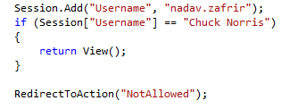
Session
The Session dictionary allow you to store state data for the current session
Keep in mind it is best to keep your application stateless
Notes:
Why stateless:
Allows cache
Scaling made easy
Saves you space: move state to the client

Slide 13
Sharing data between Controller & View
Controller Model Binding
The Controller method returns an instance of a specific model object
Only one type of Model can be bound to a View
Generally, this is the most recommended manner to pass data to a view
Controller | View
var myPerson = new Person() { Name = “Me” }; return View(myPerson); | @model Person <p>@Model.Name</p>
Notes:
There are two basic ways to share data between the Controller and View.
Bind a specific model instance to the View using a special syntax, and access it from the View using the Model keyword.
This is the best way, since it is more testable, and compiled – so you minimize runtime errors. In the second method, if you attempt to access a property on the dynamic object which doesn’t exist, you’ll get a runtime error since dynamic objects are resolved at runtime. In addition, it’s less efficient. However, there are times when we want to share small pieces of data that we don’t want to embed in our model classes, and this is when ViewBag and ViewData could be useful.
You can also precompile your views and have your compiler fail

Slide 14
Sharing data between Controller & View
Shared Objects
There are 3 properties that Controllers and Views share:
ViewBag – a dynamic object, will dispose once the view is rendered
ViewData – a dictionary, will dispose once the view is rendered
TempData – also a dictionary, will “live” until your subsequent request
Every property placed on these objects from the Controller method, will be accessible from the View
Example:
Controller | View
ViewBag.MyPerson = new Person() { Name = “Me” }; return View(); | <p>@ViewBag.MyPerson.Name</p>
Notes:
There are two basic ways to share data between the Controller and View.
Bind a specific model instance to the View using a special syntax, and access it from the View using the Model keyword.
Use special properties that are shared between the Controller and View:
ViewBag- a dynamic object
ViewData – a dictionary object
TempData, also a dictionary – will live to your next request
There is not real difference between the two, apart from the fact that they are implemented differently. Use the one you prefer.
If you choose both – keep in mind you can only use every key once (shared between them).
The recommended way is the first one, since it is more testable, and compiled – so you minimize runtime errors. In the second method, if you attempt to access a property on the dynamic object which doesn’t exist, you’ll get a runtime error since dynamic objects are resolved at runtime. In addition, it’s less efficient. However, there are times when we want to share small pieces of data that we don’t want to embed in our model classes, and this is when ViewBag and ViewData could be useful.

Slide 15
DEMO: Controller & View Interaction
Notes:
DEMO 2

Slide 16
Routing
Routing means translating a URL to an actual Controller Action
Default routing template: http://www.mysite.com/{controller}/{action}
Routing also allows us to pass parameters to an Action
For example:
http://www.mysite.com/person/getall
http://www.mysite.com/person/getall?name=Daniel
When there’s no Action specified, ASP.NET MVC will use Index
You can customize routing in the RouteConfig.cs file
Notes:
Routing is simply the linkage between the URL and the Controller method we’re invoking.
ASP.NET MVC has the basic routing configuration set up, so it’s not likely you’ll need to frequently change it yourself. However, you need to understand how it works.

Slide 17
Conventions, Conventions, Conventions
ASP.NET MVC has many built-in conventions to save boilerplate code
It’s not magic – it’s just conventions.
Structure Conventions
Controllers, Models, Views
Content
App_Start
Naming Conventions
Views are named the same as their respective Actions
Controller names
Notes:
Structure Conventions:
Controllers, Models (ViewModels, not generic Models) and View always have to be in their respectively named folders.
The Content folder is the only folder which has a special setting allowing it to serve content. For example, you’ll want to store your images and resources under this folder. If you try placing a file under another folder – for example, AppStart, you’ll get an error when trying to access it in the browser. IIS blocks this.
App_Start contains all the settings. They are loaded by reflection so you cannot move them
Naming Conventions:
If you want to use return new View(), you’ll need to put the View in the same folder structure and give it the same name as the Controller Action method. It’s possible to call an overload of this method and provide an explicit, different name – but I do not recommend you do this.
Controllers always have to be named SomethingController, and when routing to a Controller, the URL will omit the Controller segment.

Slide 18
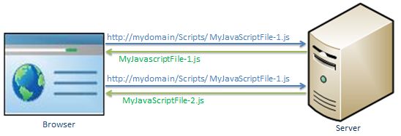
Bundling in ASP.NET MVC
Your View will probably need a few CSS and JS files
Requesting each resource individually take time and bandwidth

Slide 19
Bundling in ASP.NET MVC
ASP.NET MVC enables you to load more than one resource in a single request
You can create a ScriptBundle or a StyleBundle and define what resources will be brought when fetched
The bundle can also be minified to optimize its size
Removing white space and comments
Shortening variable names

Slide 20
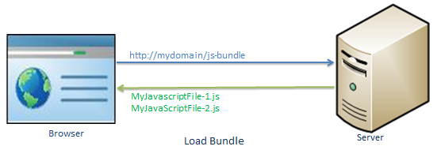
Bundling in ASP.NET MVC
Bundles are registered in the BundleConfig file
They are used in view, mostly the Layout page
BundleConfig.cs
bundles.Add(new ScriptBundle("~/bundles/jquery") .Include( "~/Scripts/jquery-{version}.js"));
Layout Page
@Scripts.Render("~/bundles/jquery")
Notes:
You can use a wildcard like {version} or “*.js”
You can add a few files or a whole directory to a boundle
Style:
bundles.Add(new StyleBundle("~/bundles/css").Include(
"~/Content/bootstrap.css",
"~/Content/site.css" ));
VIEW:
@Styles.Render("~/bundles/css")

Slide 21
Entity Framework CF & ASP.NET MVC
Entity Framework Code First plays very nicely with ASP.NET MVC
ASP.NET MVC Model classes can easily be turned into EF Entities with a simple DbContext
Be careful of common mistakes with EF & ASP.NET MVC that will have you debugging for hours
Notes:
Entity Framework Code First is to ASP.NET MVC as what ActiveRecord is to Ruby On Rails.
EF CF work together nicely with ASP.NET MVC, even though the technologies aren’t necessarily as coupled as they are as with AR and RoR (EF is a separate NuGeT package, though included with ASP.NET MVC).
When you use ASP.NET MVC with EF CF, it is extremely important you follow the best practices described in this presentation, otherwise bad things can happen.

Slide 22
Best Practices with Entity Framework in MCV
Instantiate your DbContext in every Controller’s c’tor, separately
Dispose of the DbContext instance
Enumerate data before passing it into View
Notes:
Never create a singleton DbContext - DbContext classes are not built for concurrent calls
It’s best to not declare the DbContext inside an Action
Override the Controller’s Dispose method and dispose of the DbContext instance
If declared within an action: initialize it inside a “using” block
Failure to dispose will leave an SqlConnection open for every HTTP request
The DbContext will be disposed before the View is returned
If the View is forced to enumerate a result from the DB, you’ll get an exception

Slide 23
DEMO: ASP.NET MVC EF + Posting Data
Notes:
DEMO 3

Slide 24

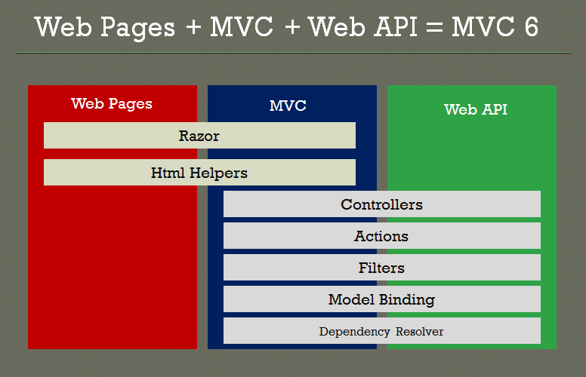
ASP.NET MVC’s successor
ASP.NET Core is an open-source re-implementation of ASP.NET as a modular web framework, together with other frameworks like Entity Framework.
The new framework uses the open-source .NET Compiler Platform (codename "Roslyn") and is cross platform.
Notes:
ASP.NET MVC, ASP.NET Web API, and ASP.NET Web Pages have merged into a unified MVC 6

Slide 25
Exercise Time – Book Store
Store all books in a database
Store Book List
Each list item will have the name of the book and a picture
Clicking on the book listing will redirect to the Book Overview page
Book Overview
Show more details – author, price, category
Book Management
Create a login page for admins (assume one hardcoded admin user)
Create a separate page allowing to add a new book, only for admin
After logging in – keep the user signed in
Allow Admin user to delete a book by showing a special button in the Book List

Slide 26
Thank You
Daniel@Goltz.info

